Slide 1
Start using data.table
Megan Stodel
www.meganstodel.com
@MeganStodel
Notes:
The reality of data science is data wrangling
Two approaches to ‘start’
Mostly about advocating / encouraging use

Slide 2
About data.table
1

Slide 3

DEFINING DATA.TABLE
A package in R
Originally released in 2006
730k downloads a month
A data structure
A way of manipulating data
Notes:
- More than generic interpretation

Slide 4
Reasons to use data.table
2

Slide 5
speed matters
One of the most common criticisms of R is that it is slow
Speed can be particularly important in some instances:
Very complex models
Very big datasets
Apps or tools designed for general use
Code that you run often

Slide 6
Data.table is fast
One of the most common criticisms of R is that it is slow
Not data.table!
Things can be modified / altered by reference, so there is in-situ replacement without duplicating the table
The binary search algorithm means it efficiently finds values by searching a small section of the sorted data
You can perform numerous operations in one line, so don’t have to allocate memory for the intermediate result
Speed extends to reading in data using fread()

Slide 7
Benchmarks
-- Aggregation benchmarks here –
Data.table is consistently substantially faster, not only than dplyr, but also pandas and data structures in other languages.
Relative performance increases as data size increases.

Slide 8
Few dependencies
Data.table
dplyr
methods (base)
assertthat
glue
magrittr
pkgconfig
R6
Rcpp
rlang
tibble
tidyselect
utils (base)

Slide 9
Using data.table
5

Slide 10
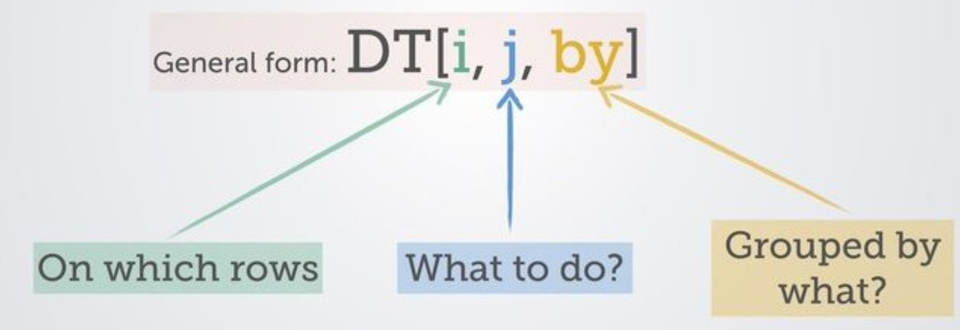
The syntax
(source)

Slide 11
In-situ definition and replacement
:=
This combination of characters is how to create or modify a column without needing to create a copy of the dataset.
DT[, bigger_number := number_column + 1]

Slide 12
Built-in variables
Symbol | Purpose
.N | Number of observations in the group DT[, .N] Counts the number of observations (rows) in the data.table
.SD | Subset of Data. A way of referencing all columns except the grouping columns. So rather than individually calling functions on each column, can use .SD to apply to all of them, used in conjunction with base function lapply(). DT[, lapply(.SD, mean)] Calculates the mean for every column

Slide 13
Lists in data.table
As long as j returns a list, each element of the list will become a column in the resulting data.table.
If you only want certain columns in your data.table, you can achieve this using a list, which in its short version is .()
twocol_DT <- DT[, .(column_a, column_b)]
This is true even if you want a one column data.table
onecol_DT <- DT[, .(column_a)]
If you don’t have your single column in a list, it will become a vector (which is often useful)
vector <- DT[, column_a]

Slide 14
Changing column names
Rename by reference with setnames()
setnames(DT, “original_name”, “new_name”)
setnames(DT, c(“a”, “b”, “c”), c(“A”, “B”, “C”))
Or change names as you choose which columns to keep
new_DT <- DT[, .(new_name = old_name,
new_column = old_column)]

Slide 15
Chaining
Similar to piping, you can chain data.table commands
DT[, .N, by = month][order(-N)][1:3]

Slide 16
Example:
DT[year == 2018, profit := sales – spend]
Filter the data.table to rows where the year value is 2018
Create a new column called “profit” that calculates the result of the number in the “sales” column minus the number in the “spend” column
(nothing in the “by” column)
Notes:
Also: columns are referred to as if they are variables, don’t need to use quotation marks or $
Also: note the way to assign without mutating using :=

Slide 17
Example:
DT[, .N, by = location]
Not filtering by anything (but need the comma)
A way to count the number of rows (like nrow())
Do this action for each distinct “location”

Slide 18
Switching to rmarkdown…

Slide 19
Useful resources
data.table site
data.table FAQ
A data.table and dplyr tour (includes comparison of operations in both packages)
Advanced tips and tricks with data.table (this is so good!)

Slide 20
QUestions
Megan Stodel
www.meganstodel.com
@MeganStodel

